Slide 1
Washing Machine Upselling
By : The Wise Owl

Slide 2
CONTENT
REGISTRATION PAGE
INSTRUCTIONS PAGE
DISCLAIMER PAGE
GAME PAGE
PRODUCT RECOMMENDATION PAGE
THANK YOU PAGE

Slide 3
TECHNOLOGY
HTML, CSS, JAVASCRIPT
PHP, LARAVEL, JQUERY
MEDIA QUERY, BOOTSTRAP

Slide 4
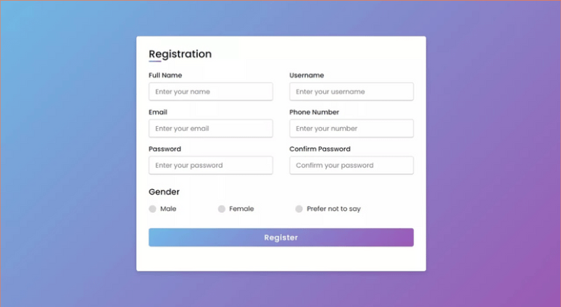
REGISTRATION PAGE
NAME
MOBILE
EMAIL(optional)
LOCATION : - MP - CH
PINCODE

Slide 5
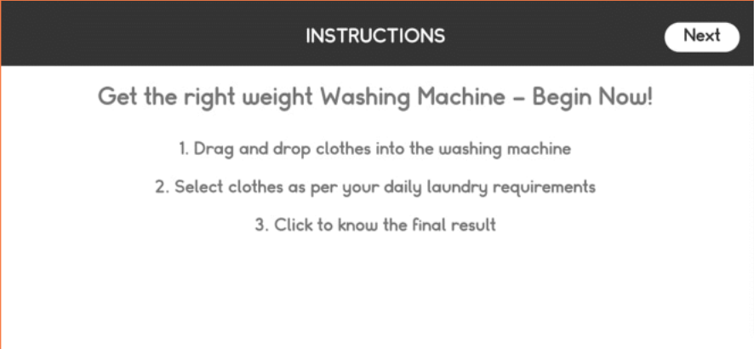
INSTRUCTION PAGE

Slide 6
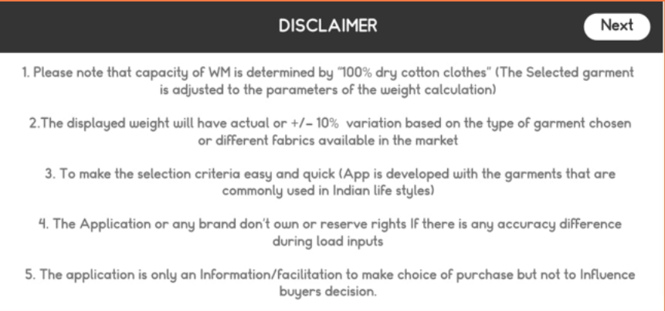
DISCLAIMER PAGE

Slide 7
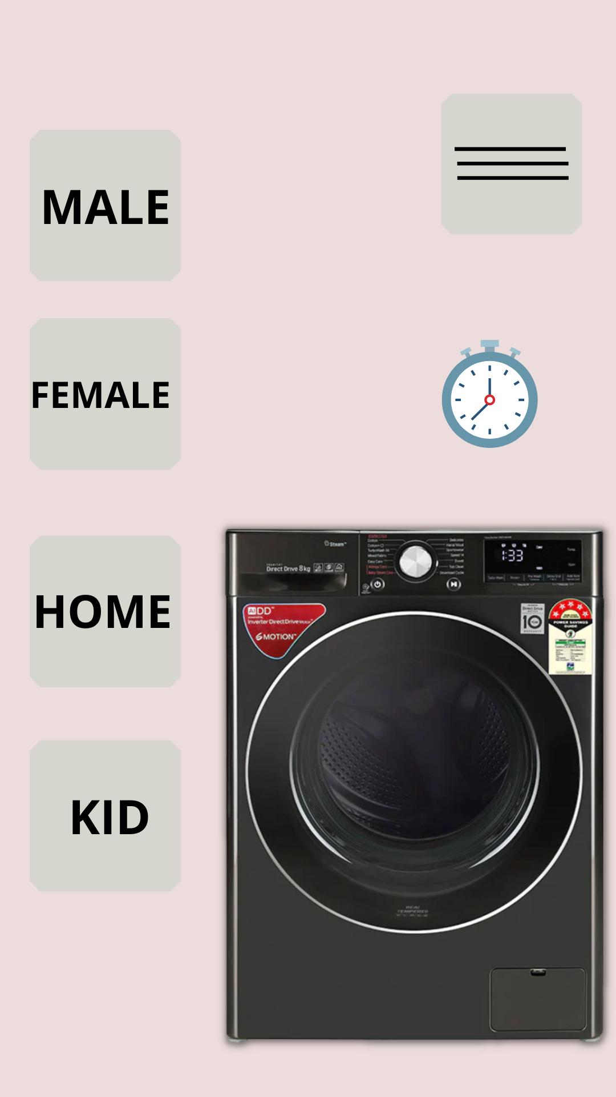
GAME PAGE
ROUGH IMAGE

Slide 8
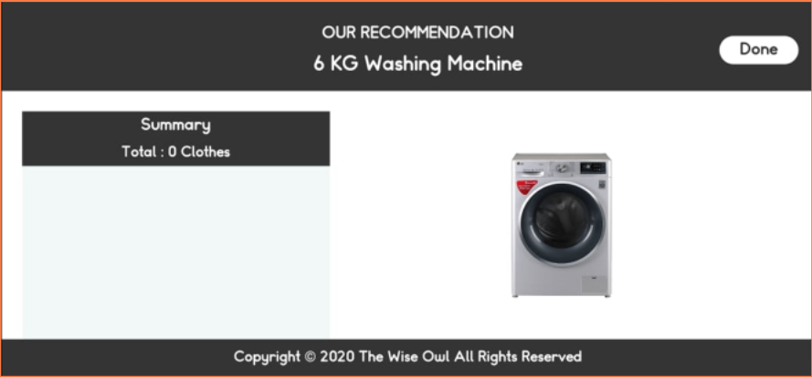
RESULT PAGE

Slide 9
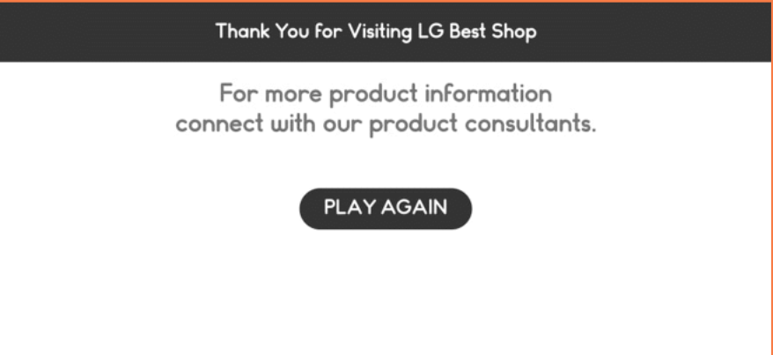
THANK YOU PAGE

